Slide 1

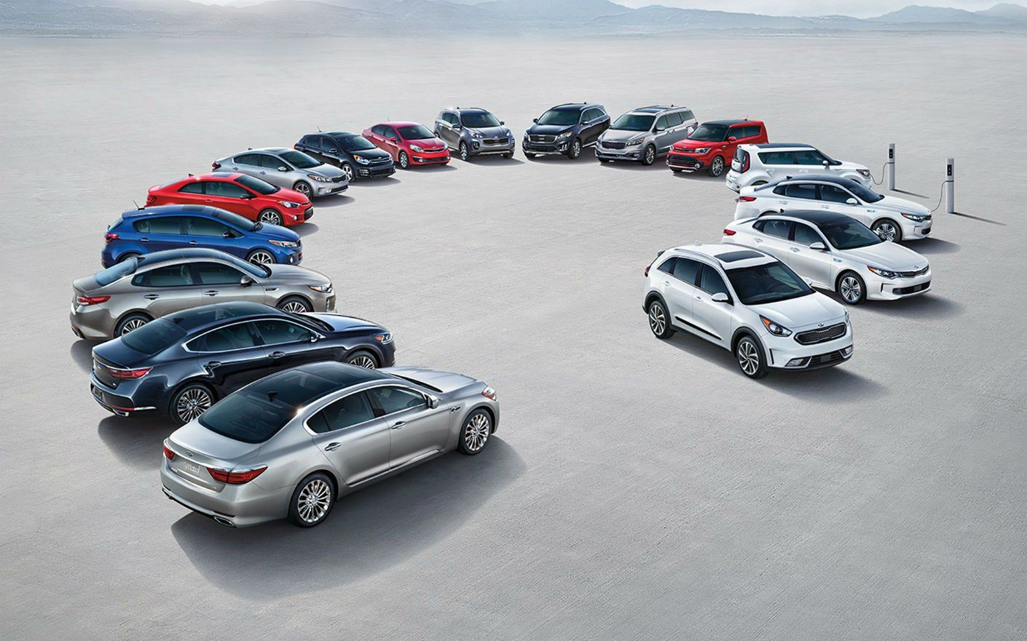
Kia Motors Analysis
Usman Khan
September 12, 2019
Notes:
First of all I would like to offer my sincere thanks to all of you for providing me the chance to work over a project that helped me to understand and analyze the Canadian automobile industry and gaining a good command of Power bi. In the presentation I would analyze the industry and will focus on Kia’s performance in the last 18 months.

Slide 2
Snapshot of Industry
Market Analysis & Trends
1
1
2
Kia – Brand, SEG, LOC
I. SWOT Analysis of Kia
Scope
II. Strategy to Increase Stinger Sales – 06m, 5y
2
Who to sell?
Luxury Segment COMP
3
Where to sell?
3
Luxury Segment Selected
4
How to sell?
4
Use MS Power BI for Analysis
Include Additional Info. if necessary
Make a presentation and present it
Notes:
The first step towards the project started with the development of a framework that would help me in analysis and presentation flow for a better understanding of the results. The framework is based on the scope that was assigned to me. I was asked to develop a SWOT analysis of Kia and the action plan for increasing Stinger sales with a plan for 06 months and 5 years. The scope will be achieved by carrying out three additional tasks which are – using power BI for data analysis, using extra information if necessary and developing a presentation for sharing results.

Slide 3
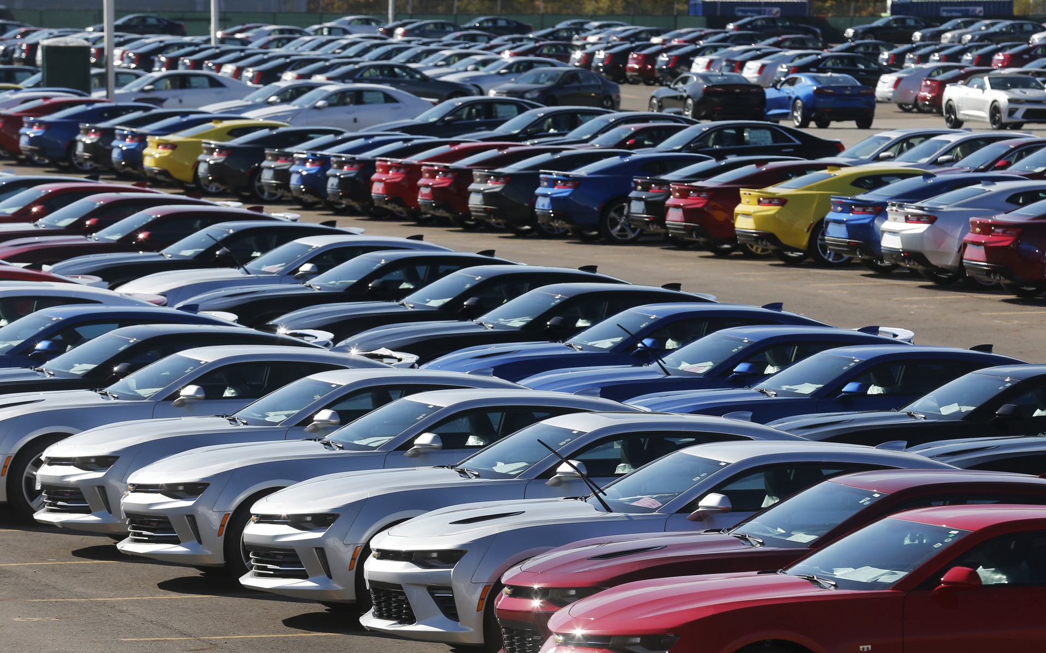
Data Analysis

Slide 4
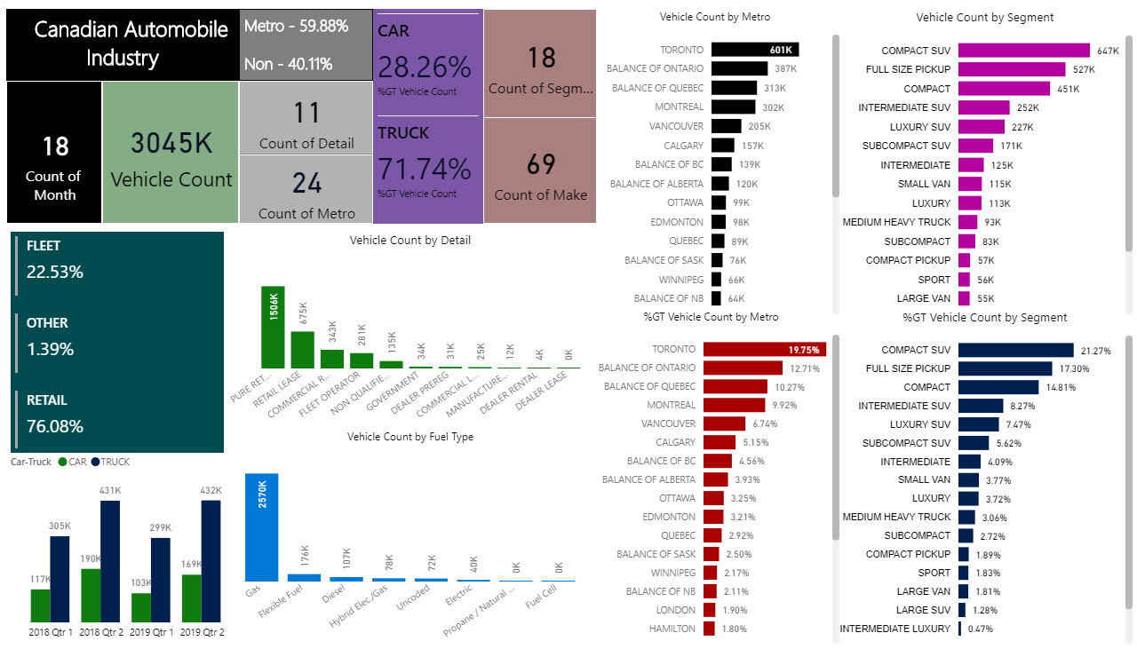
Notes:
Slide 04: First I would like to give a snapshot of the Canadian automobile industry which is based on the data that I got and is of 18 months. We can see the most popular segments and the where most of the automobiles are sold. Two things are important here – first is Toronto as a market and second is SUV as the leading segment. Luxury segment comes at 09th place in sales numbers. Importance of quarter 02 as compared to quarter 01.

Slide 5
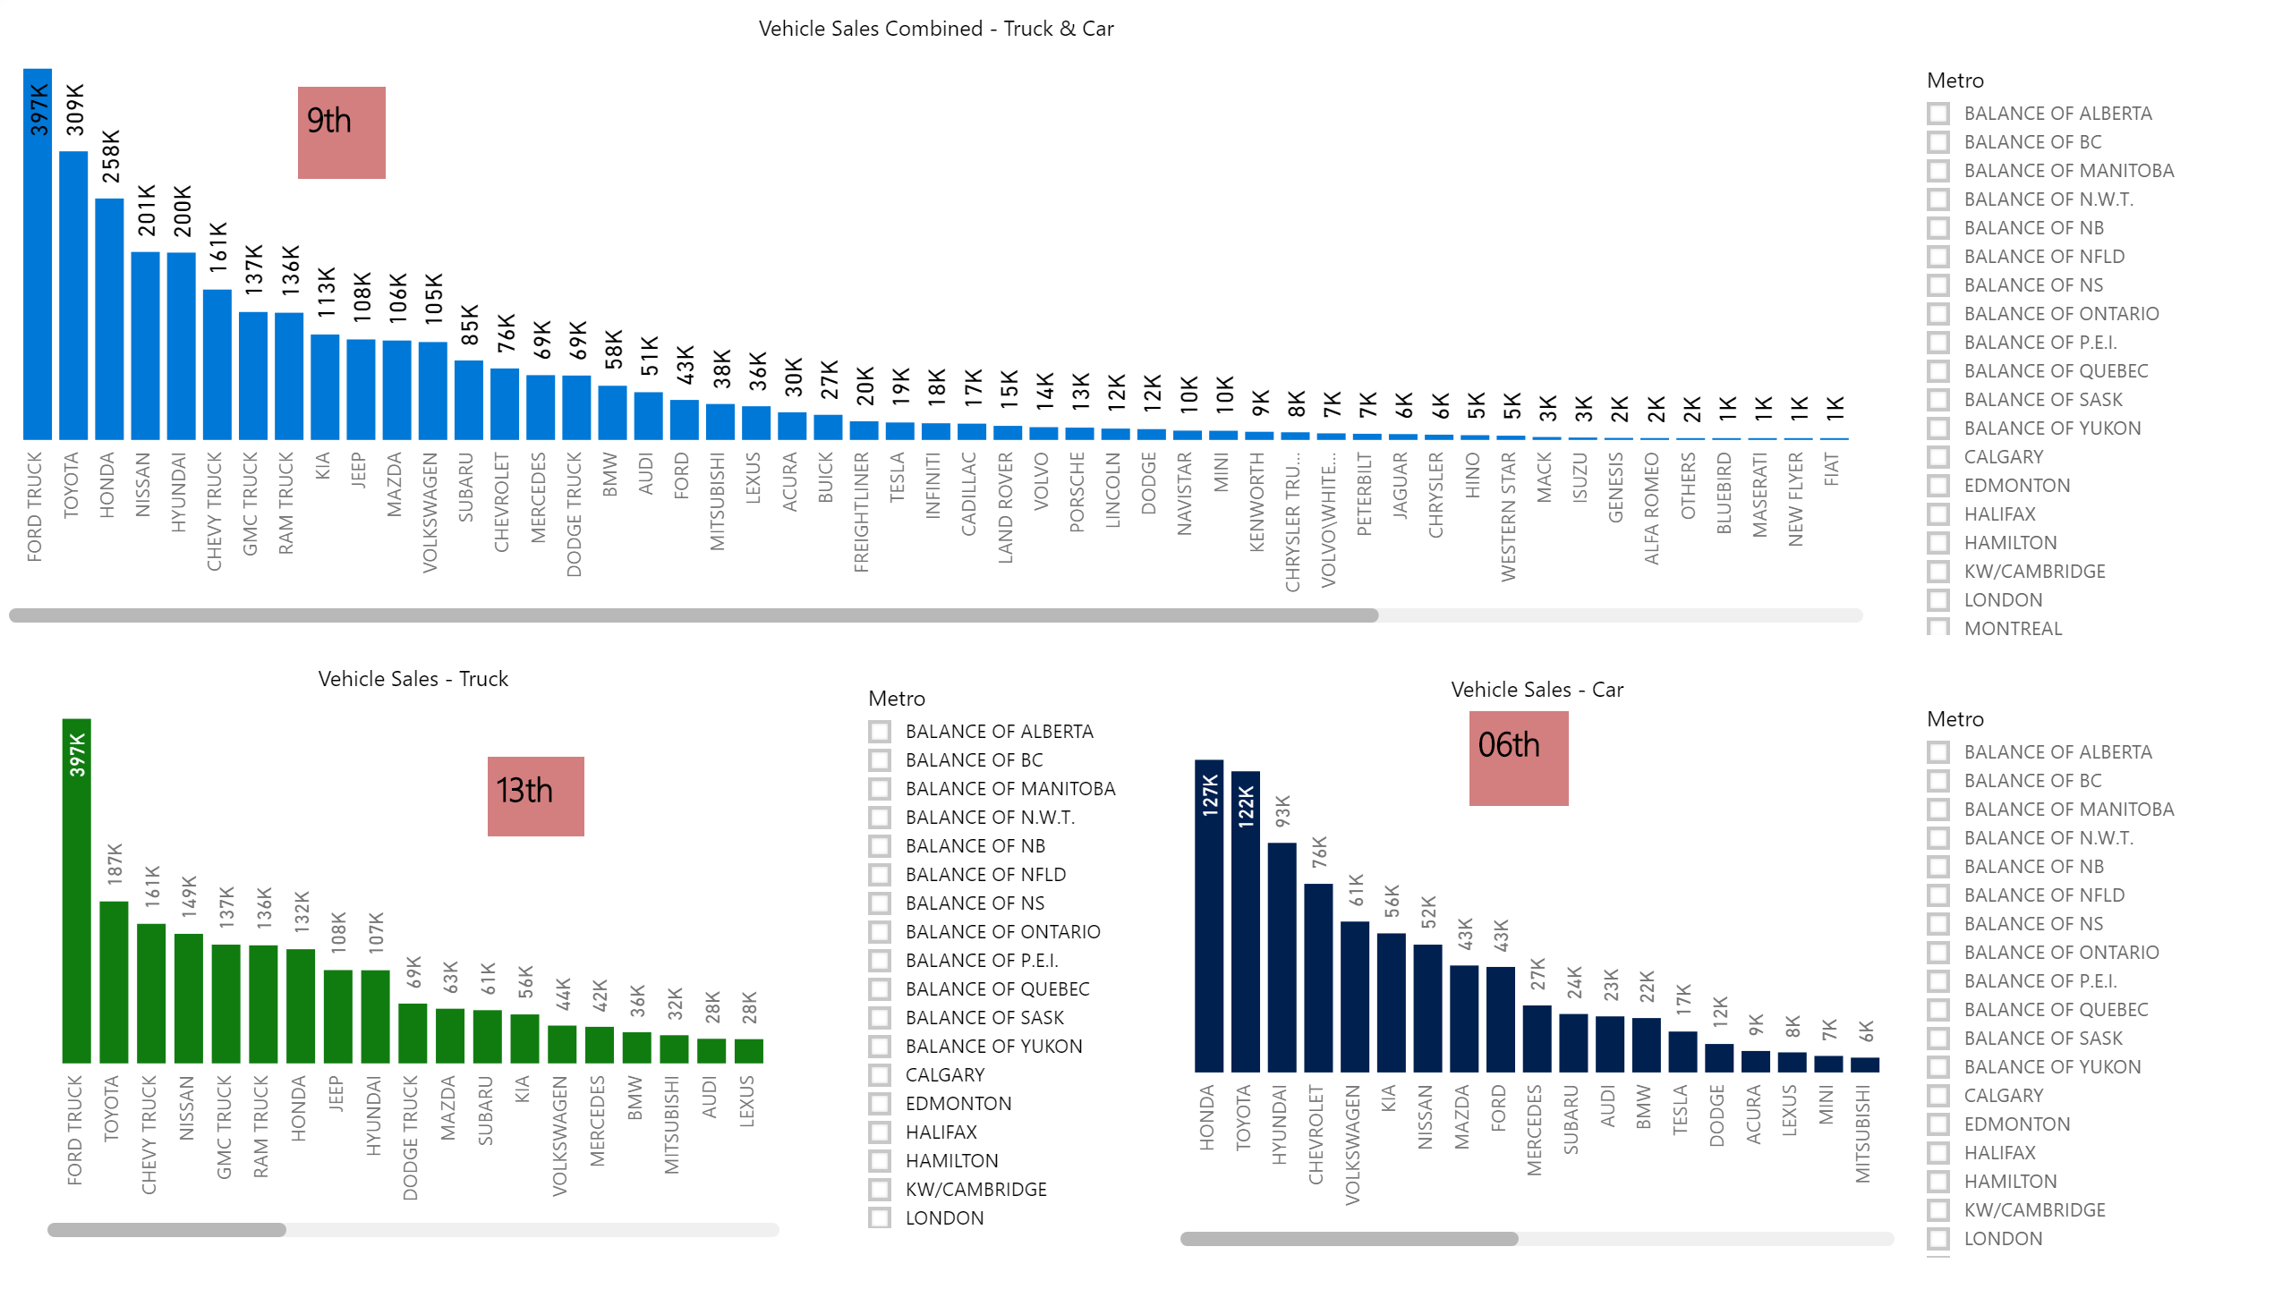
Notes:
Slide 05: The good point is that Kia is at number 06 in car sales but the problem is that the car segment is shrinking and Kia needs to improve its position in the SUV segment.

Slide 6
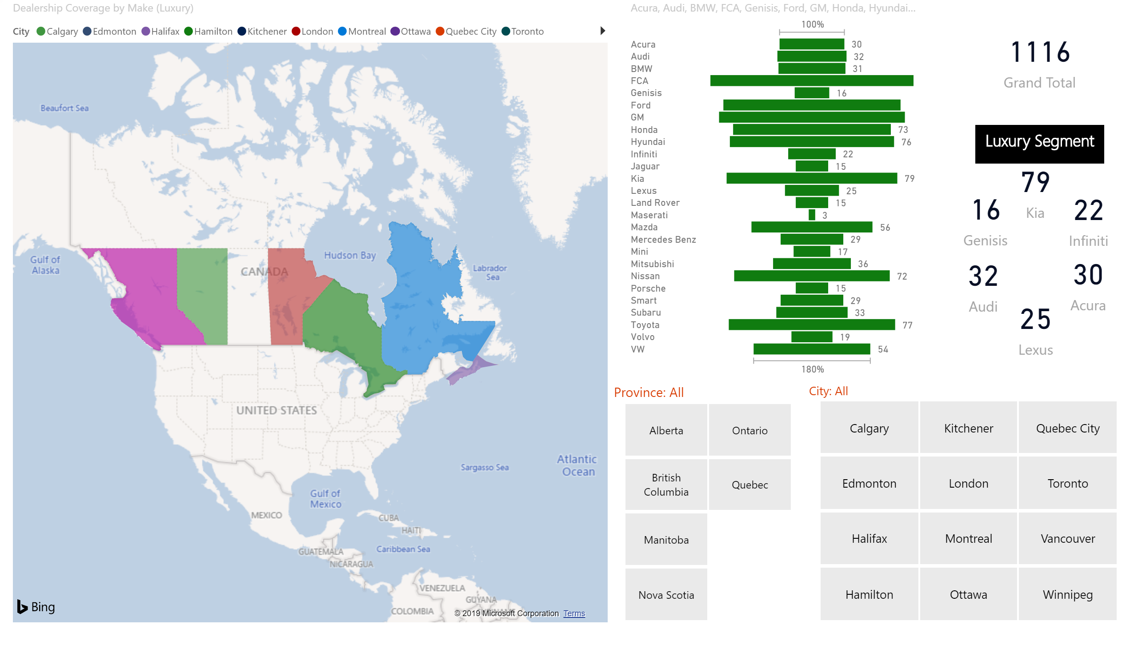
94
82
86
Notes:
Slide 06: Kia is number 04 in terms of number of ownerships in Canada and coverage. Kia is at the top in the selected luxury segment.

Slide 7
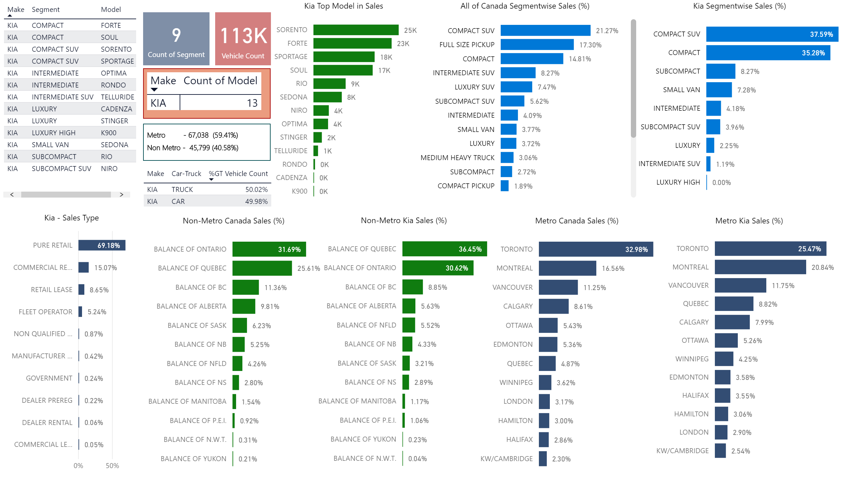
Notes:
Slide 07: Kia sells in metros and non-metros as per the industry average. The only problem is that Kia sells more cars in compact SUV and Compact segments and the most popular brands is also in these segments. Kia is not selling in other segments which show that customer prefer for compact segments and prefer other brands in other segments. Kia also sells less in the biggest automobile market Toronto.

Slide 8
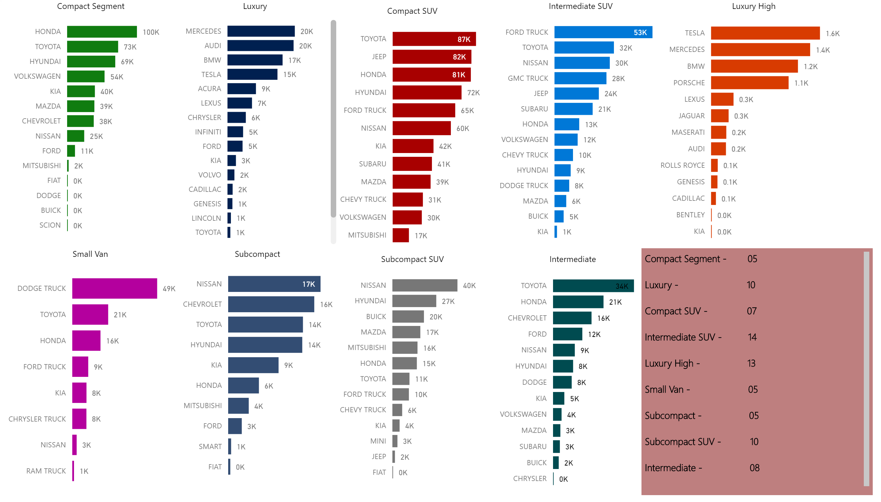
Notes:
Slide 08: Clearly shows the exact picture of Kia position in every segment. It is clear that Kia is popular in compact, subcompact and small van segments.

Slide 9
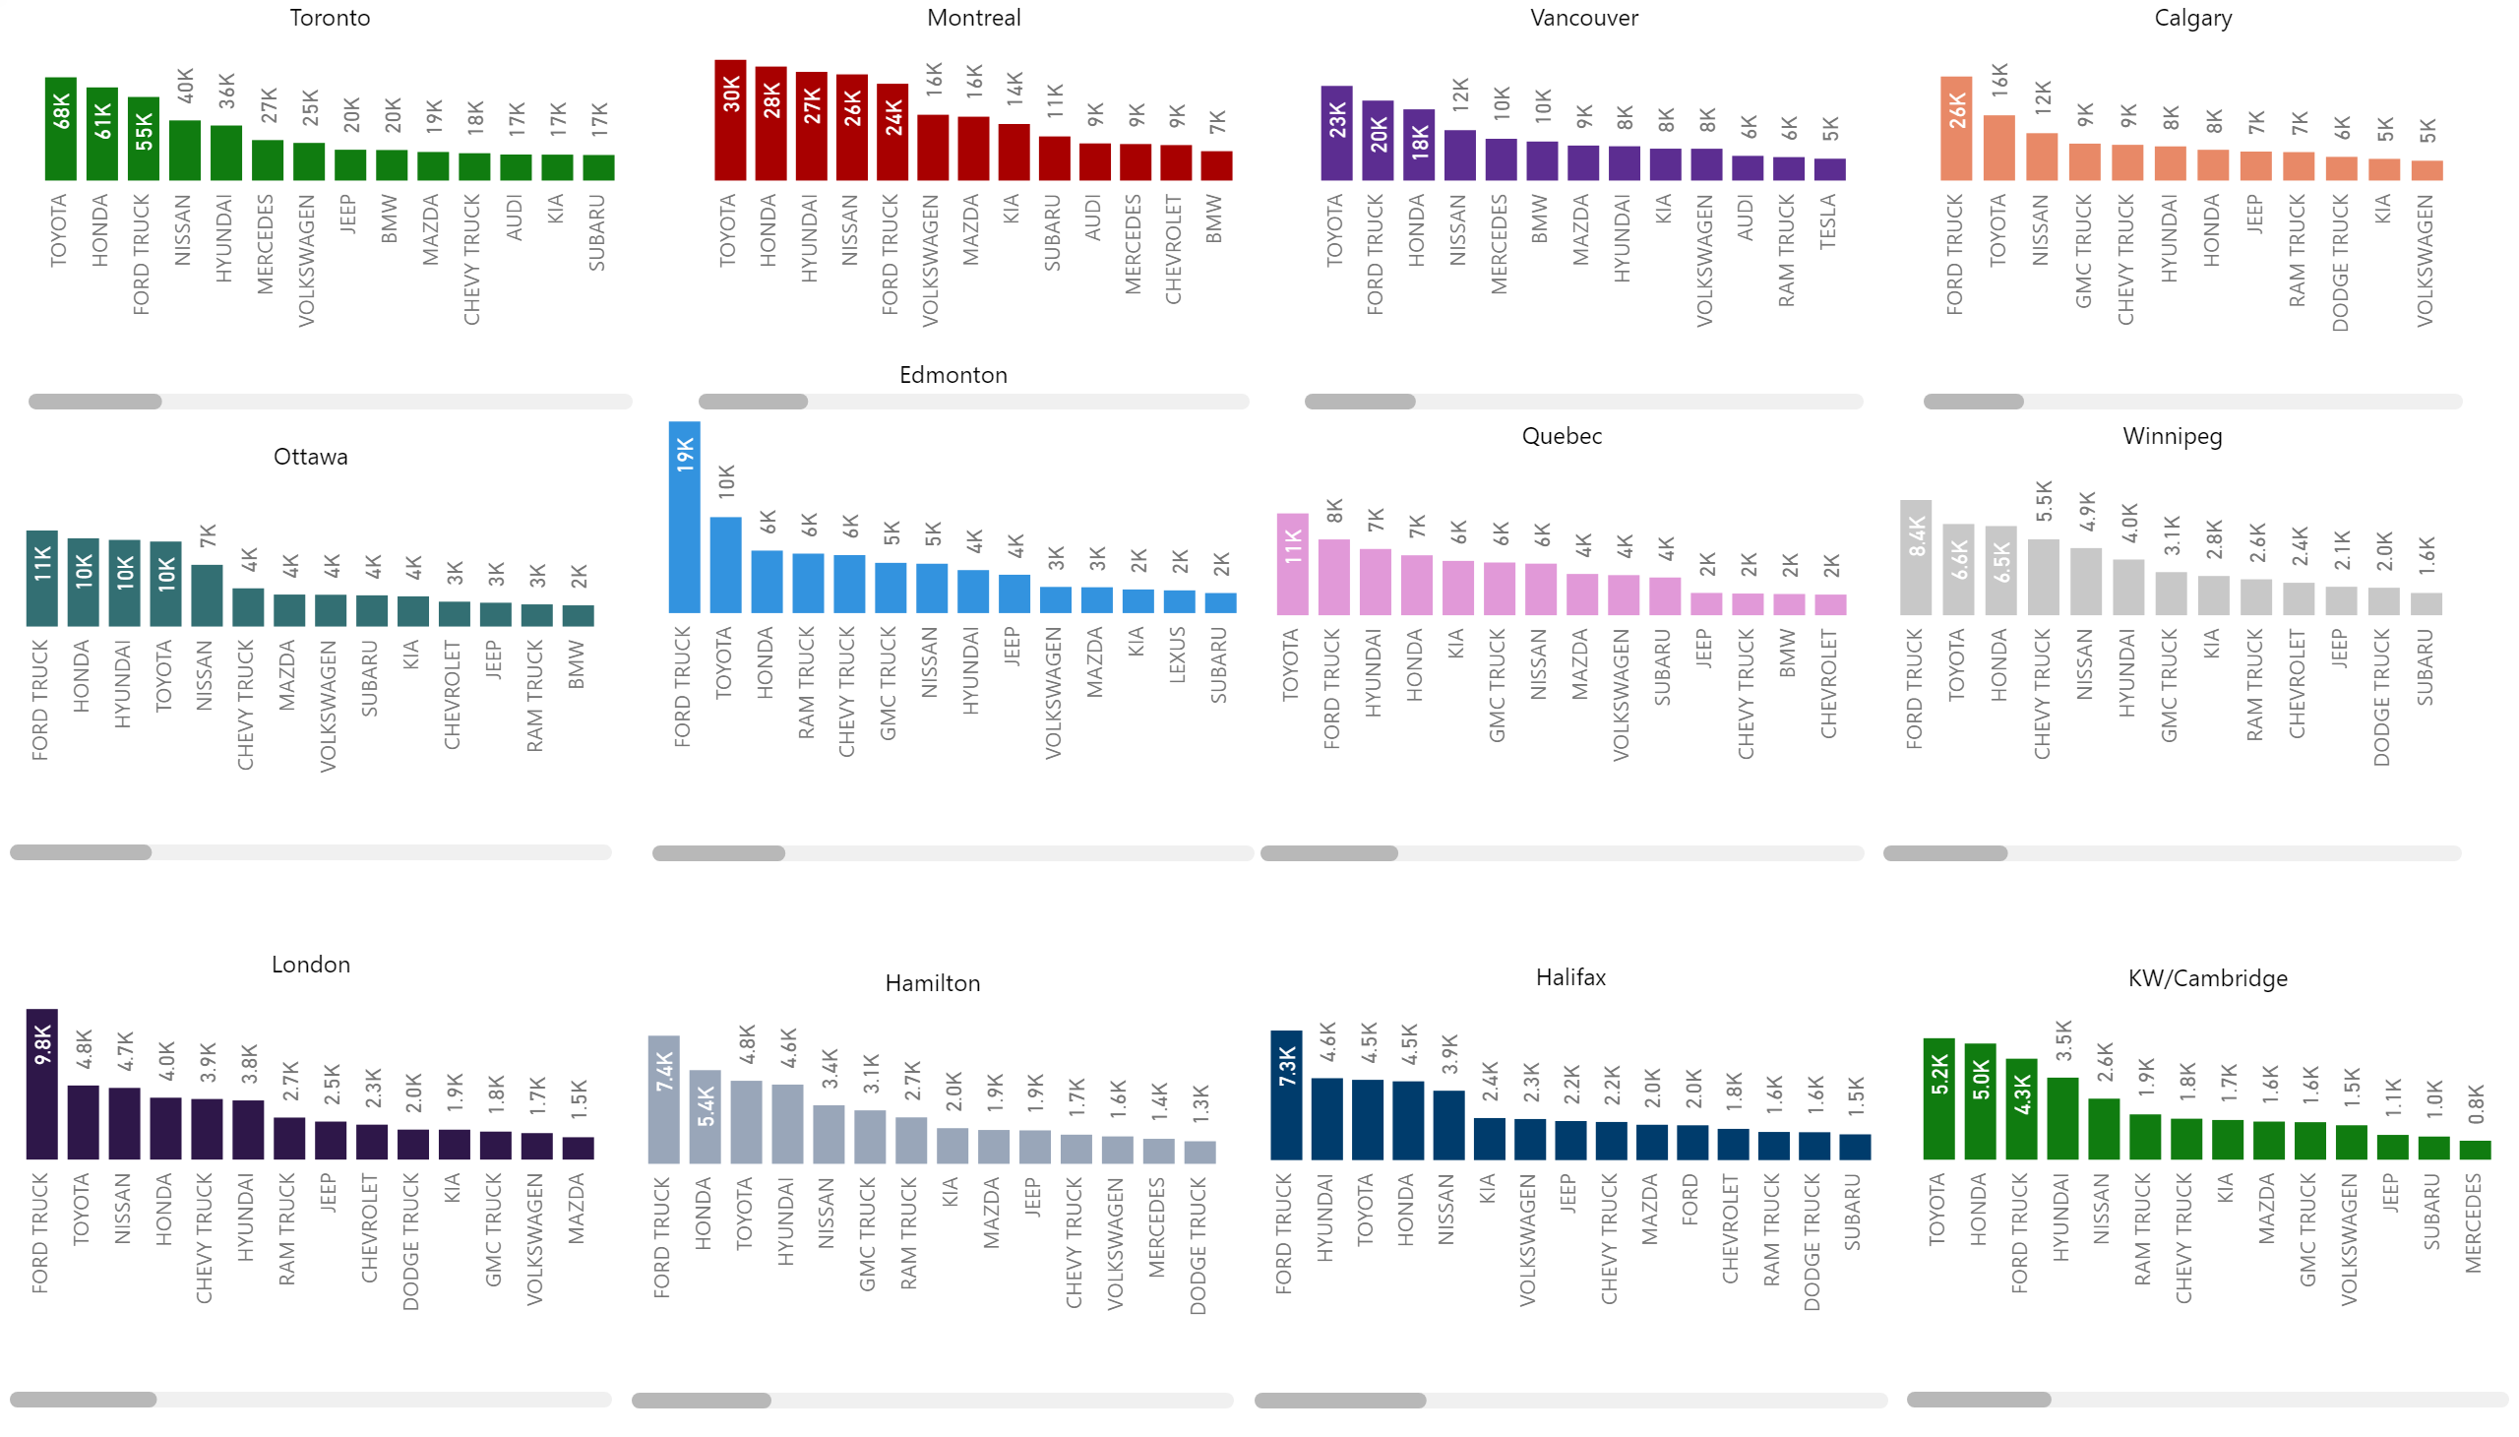
13
08
09
11
10
12
05
08
11
08
06
08
Notes:
Toronto is the worst and Quebec and Halifax are the best. But in numbers Toronto is the most important .

Slide 10
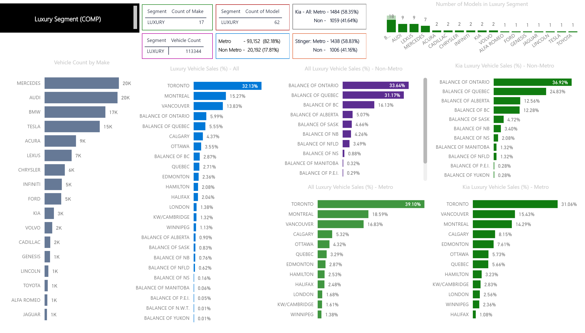
*Autotrader.ca: Ontario represents an “outlier”. Ontarians are interested in classics, performance and style.
Notes:
Custometrs in Metros are most difficult to satisfy as they are have more media-savy and many other options and compare their vehicles with others.

Slide 11
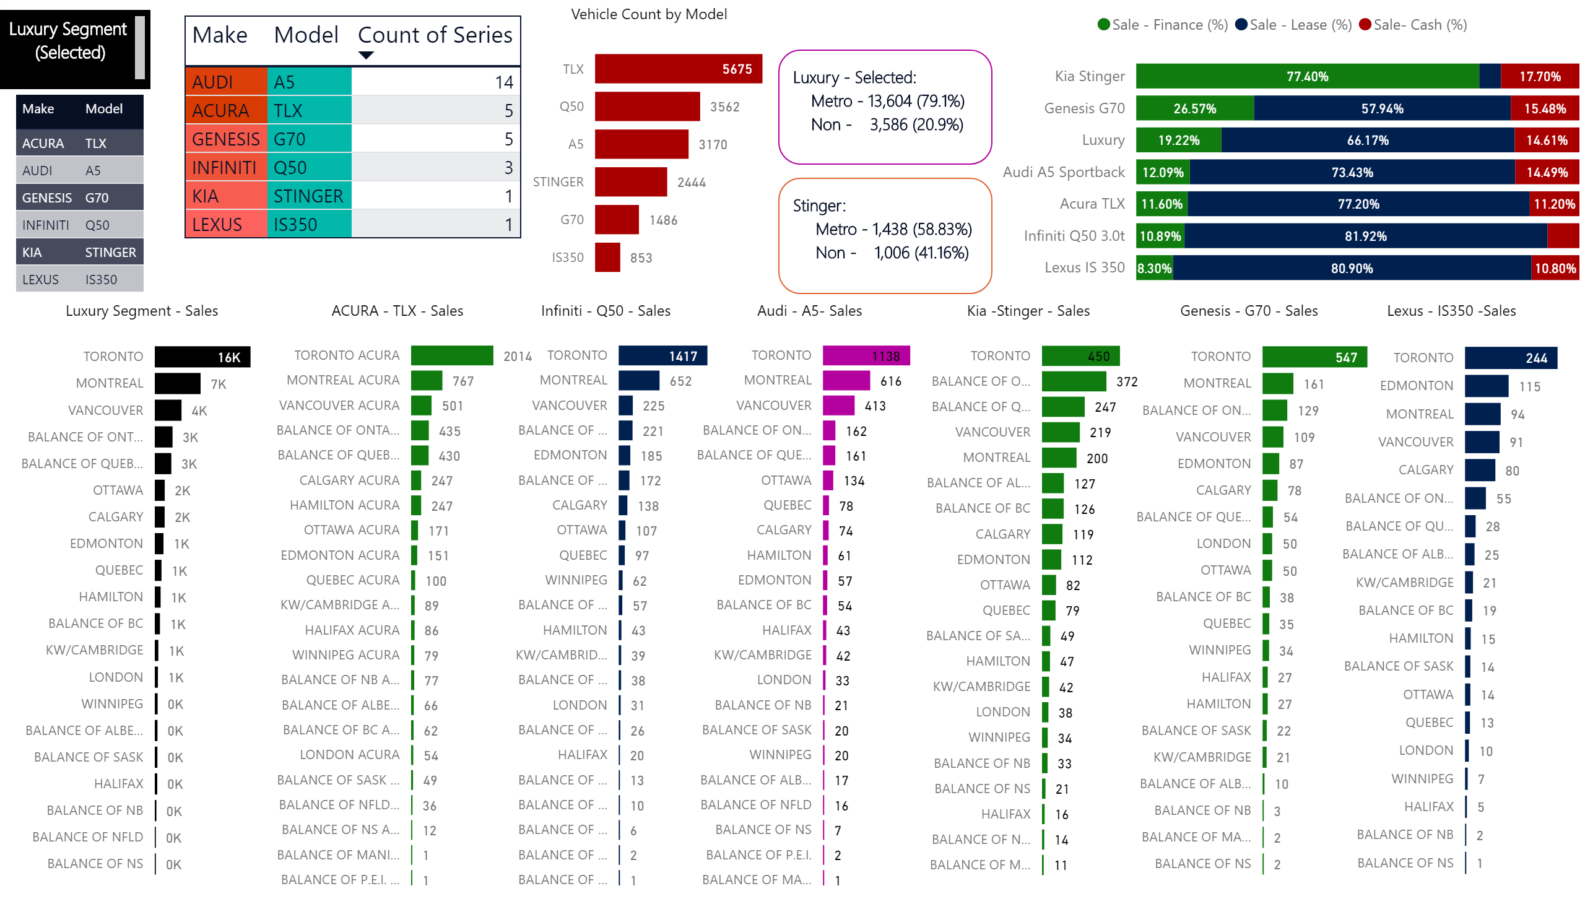
Notes:
Luxury segment as the sleected one with all the trims.

Slide 12
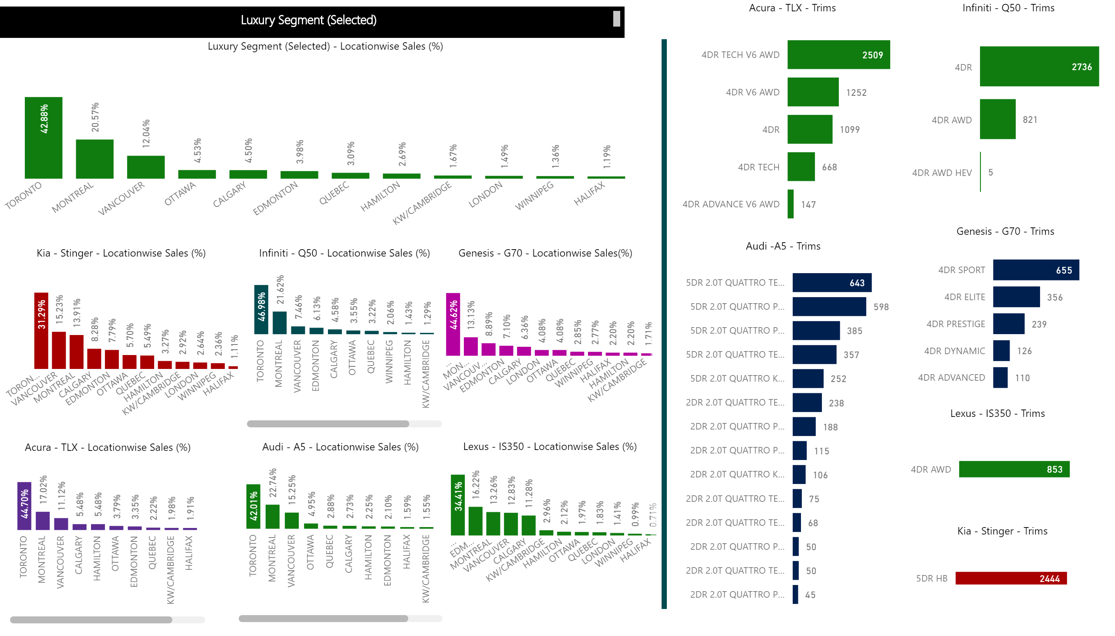

Slide 13
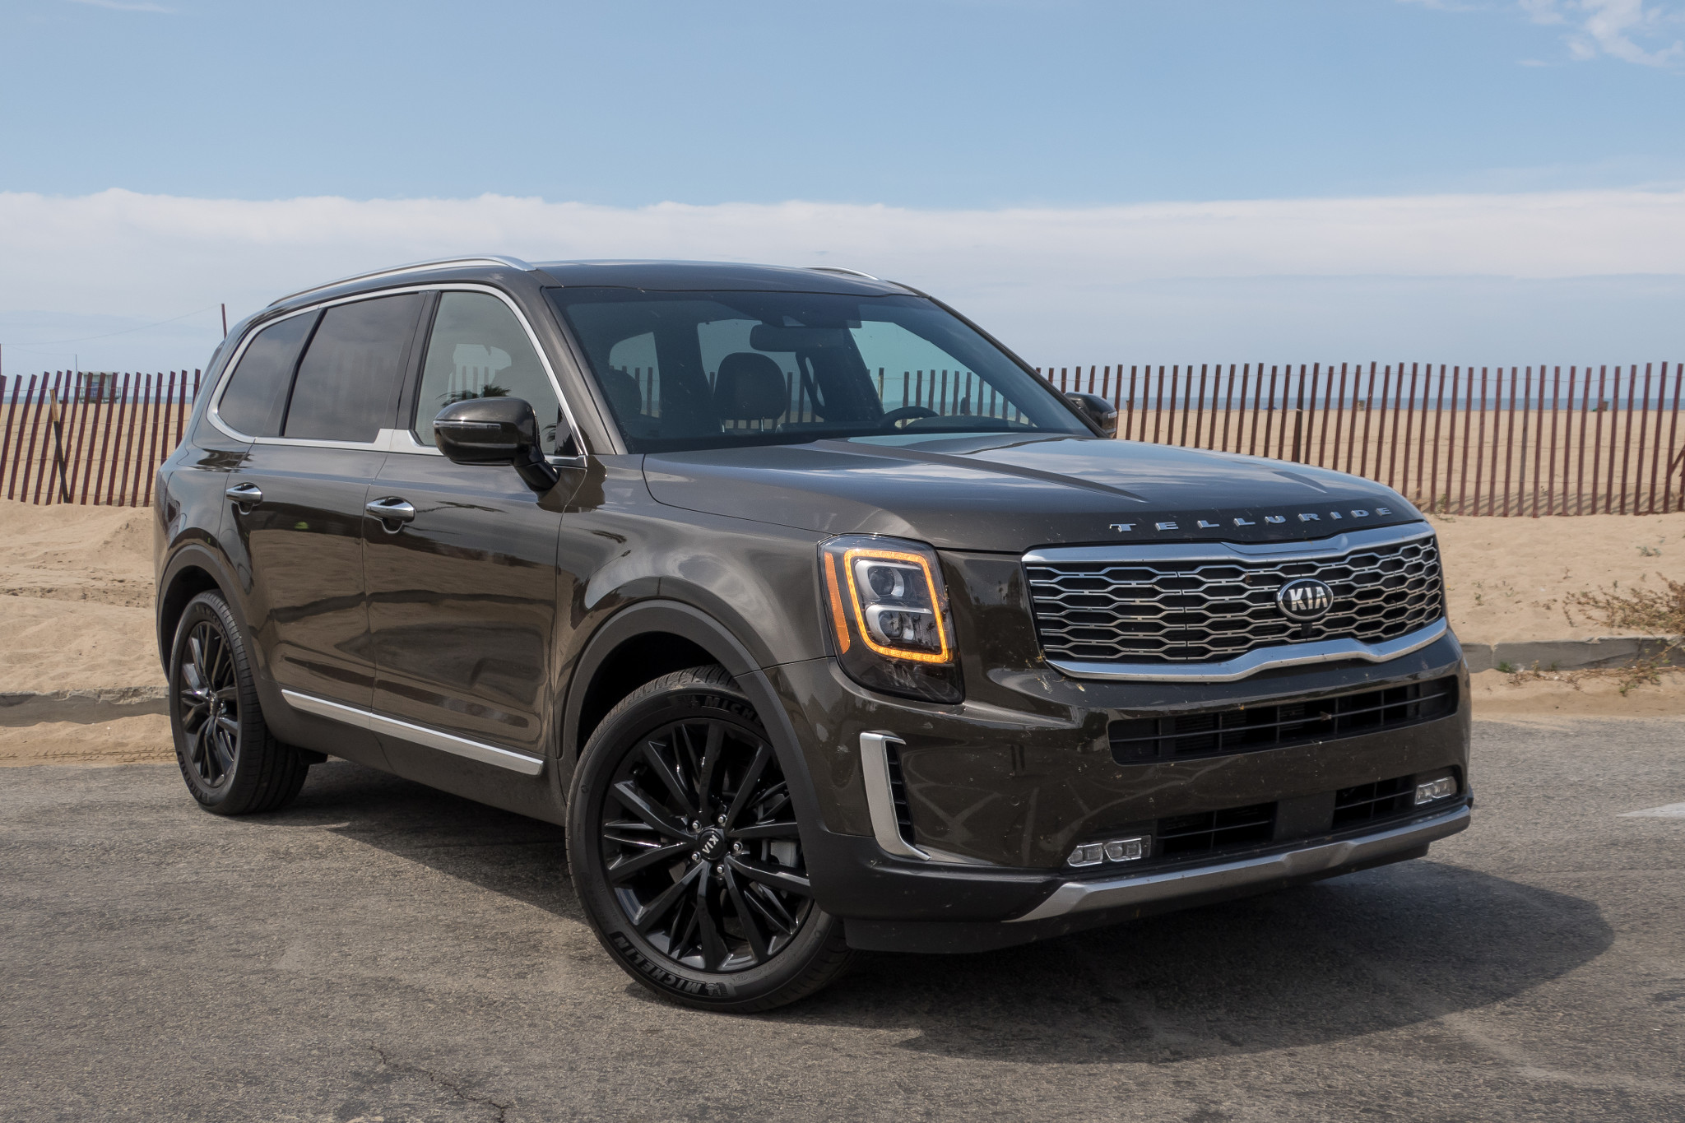
SWOT Analysis

Slide 14
Helpful
Harmful
Internal
Product Portfolio – wide product portfolio, offering 18 models in multiple segments
Positioning – value for money, kudos from experts & reviewers
Product Innovation – Successful record of developing new products
Quality - J D power and other awards for quality and less number of problems
Constant Sales - N0. 09 in Canada overall, 13th in Truck category and 6th in Car category - Sold more than 112K vehicles in 18 months (Jan 2018 – June 2019).
Strengths
Brand Recognition – Kia struggles in brand recognition when it competes against German & Japanese – Audi , Acura, Infiniti
Recalls – Past recalls of critical parts
Limited Customer Market – Kia has not been able to increase their potential market and is unable to appeal to a broader audience specially the customer in metros
Limited Sales In Luxury Segments – Kia has not been able to attain required sales numbers in the Luxury, Luxury High segments and intermediate segments despite offering some great products
Weakness
External
Dealership Network – A strong dealership network in Canada – 79 in Canada
Market Potential – Kia can create markets for new products
Green Cars – Kia can usher a new era of electric cars to capture the buzz and customer needs – Soul EV, Niro EV
Good Offers and Reliable Warranty – Customer-friendly offers, nice warranty, less residual value (lease)
Popular Models – Kia has sold equal number of vehicles in Car and SUV categories which shows the popularity of its models
Opportunities
Competition - The competition is getting stiffer in all over the world and in Canada
Profit Margins – With increased competition, players are unable to earn decent profit margins
Customer Preferences – Changing customer preferences and regulatory framework
Limited Sales in Many Segments – Apart from the Compact and Compact SUV segments, Kia has not achieved decent sales figures in rest of the segments. Kia brand is not synonymous with luxury vehicles.
Threats

Slide 15
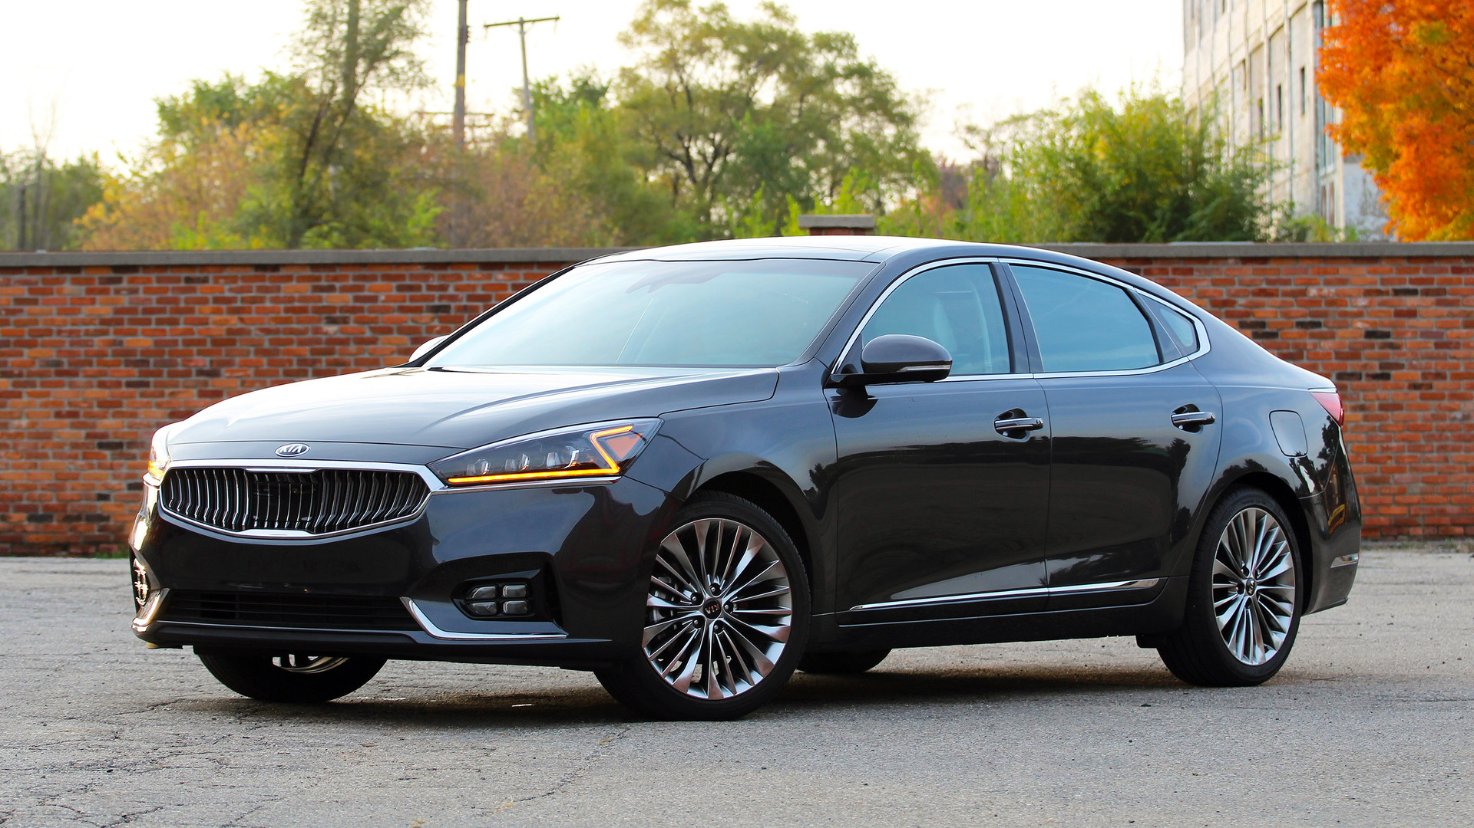
Market Analysis & Trends

Slide 16
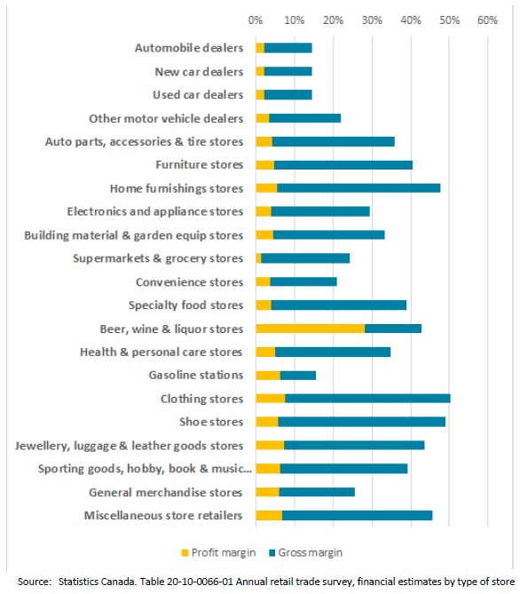
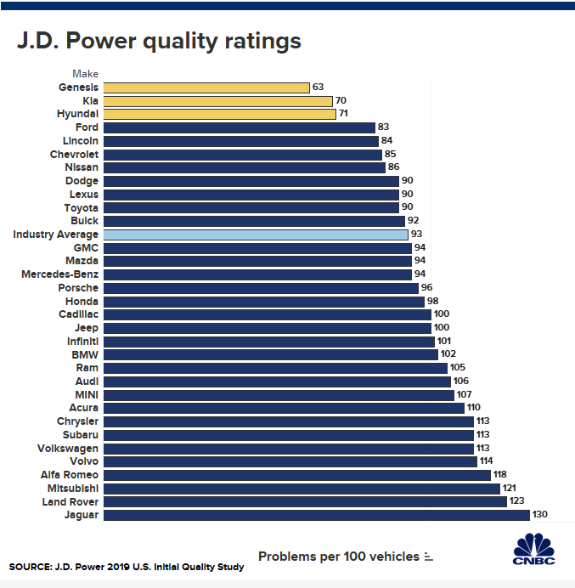
Tough Market
Good Products

Slide 17
Notes:
Statista. (April 23, 2019). What brand is your primarily used car? [Graph]. In Statista. Retrieved August 29, 2019, from https://www.statista.com/forecasts/998455/car-usage-by-make-in-canada
StatCan. (March 23, 2019). Retail sales of new car dealers in Canada from 2012 to 2018 (in billion Canadian dollars)* [Graph]. In Statista. Retrieved August 29, 2019, from https://www.statista.com/statistics/431926/retail-sales-of-new-car-dealers-in-canada/
StatCan. (April 17, 2019). Vehicle sales in Canada from 2005 to 2018 (in units) [Graph]. In Statista. Retrieved August 29, 2019, from https://www.statista.com/statistics/265955/vehicle-sales-in-canada/

Slide 18

Stinger – Marketing Strategy

Slide 19
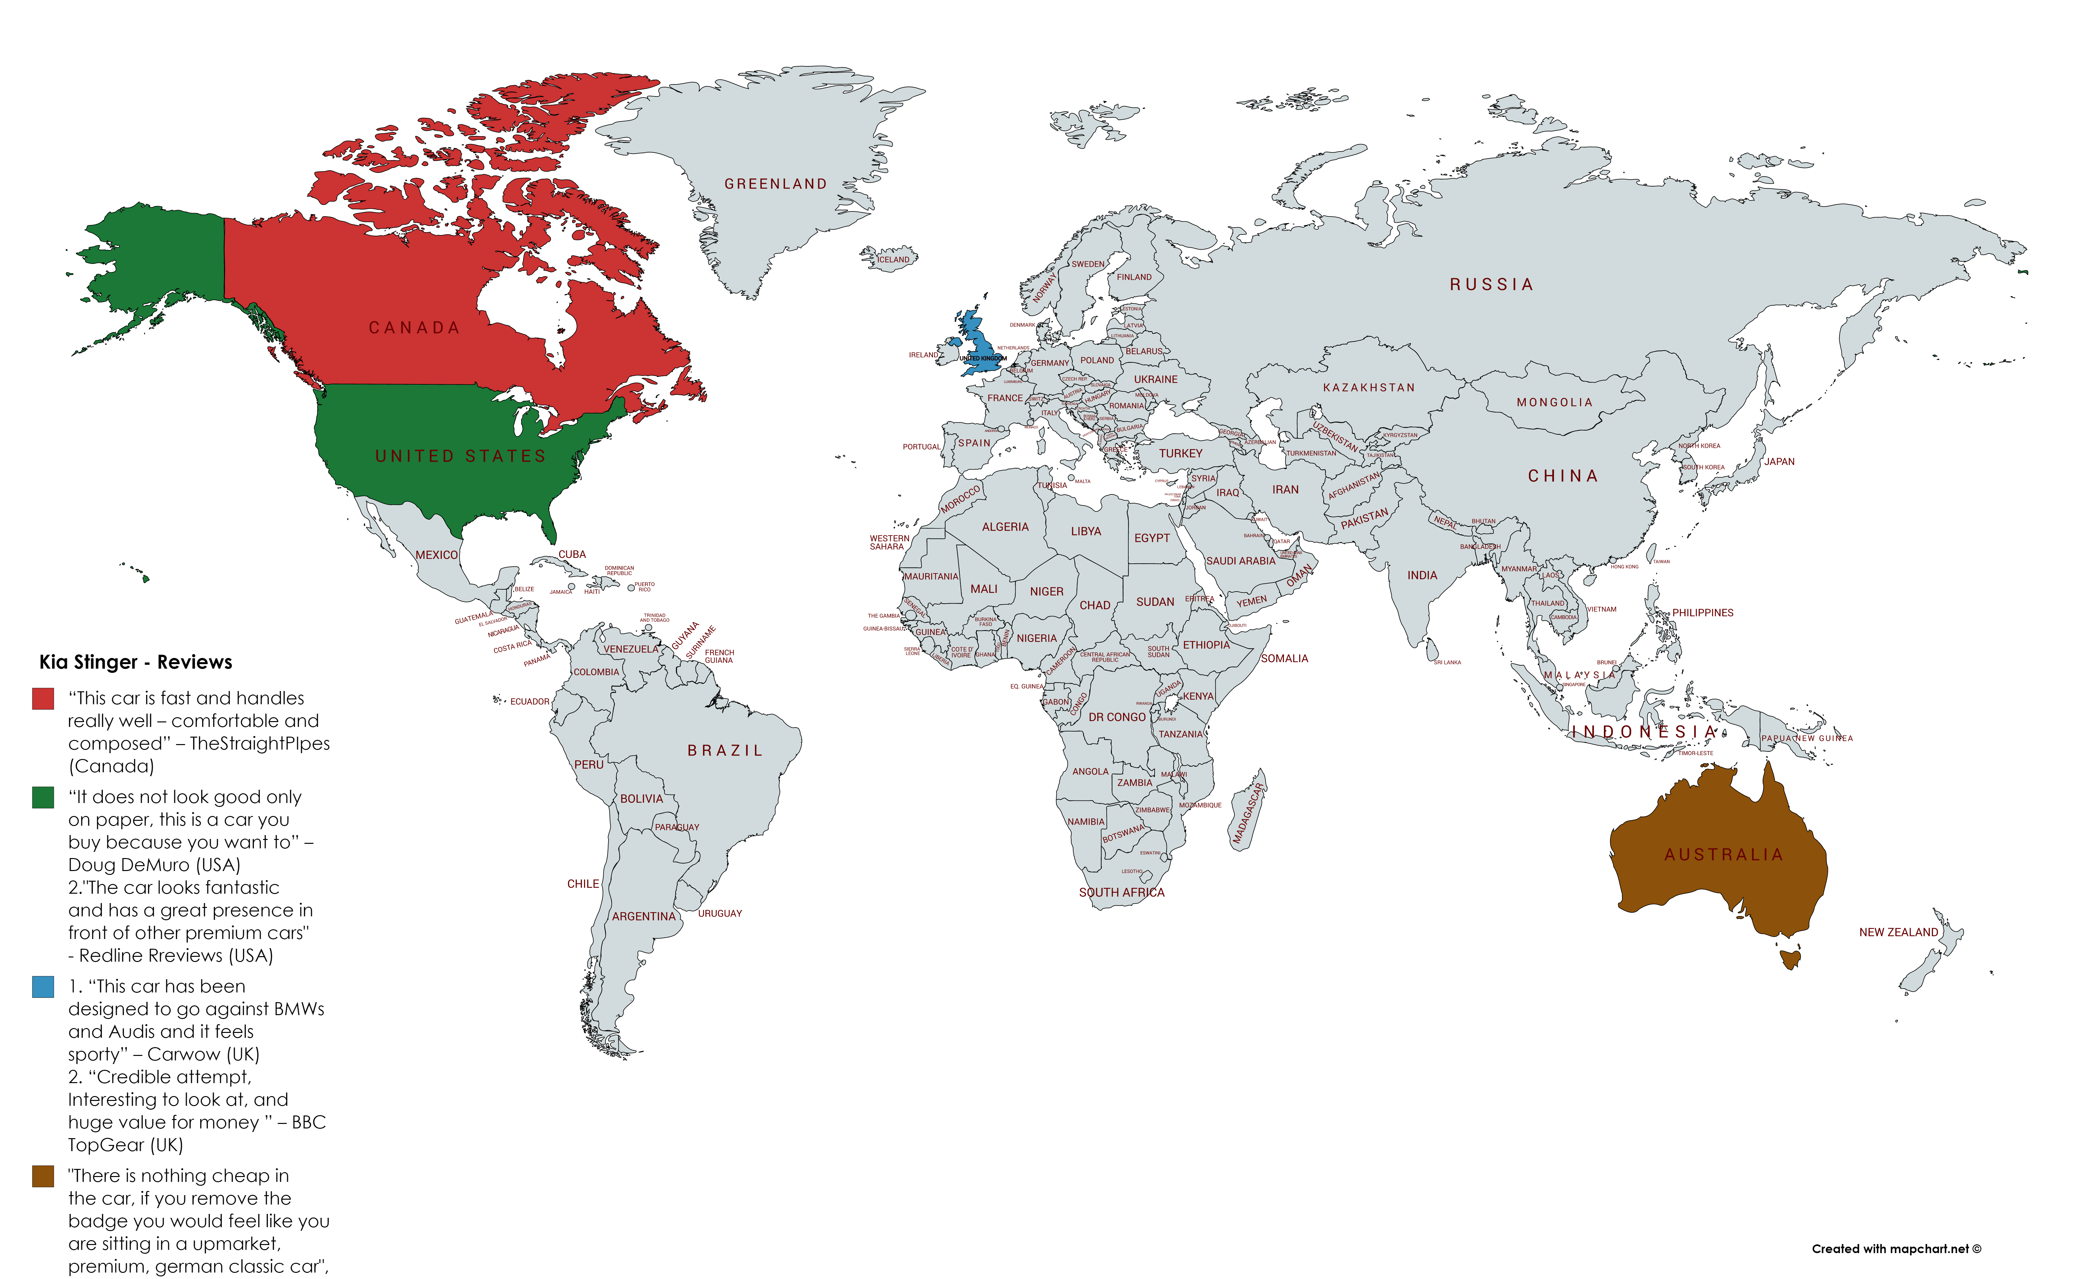







Map

Slide 20
Market Landscape

Slide 21
Canadian Population
~ 37.39 million
Notes:
Knowing the fact that Stinger is a performance car and represents Kia in the Luxury Car category, potential customers should be grouped to improve customized messaging for an impact. Grouping can be carried out to achieve segmentation based on demographics or lifestyle. The idea is to carry out impactful marketing campaigns for increased sales. Through the segmentation process, we would also be able to understand our potential customers’ needs, aspirations and the best available mediums for communication.
In the Canadian market, the millennial segment is an attractive segment for Stinger sales as they are huge in numbers, and they can afford a performance car. They are also intrinsically motivated and normally don’t buy anything out of mere necessity. They have the extra disposable income to spend on a luxury vehicle. Although they look for good bargains but love to have value-for-money for big-ticket items, that is what Stinger offers. If they are confident about a product then they would buy it rather they shop around. They are brand conscious as they love to share their experiences online with peers – they spend extra money on eating out and experiencing different things. They like to have interaction with their friends through social media. Majority of millennials are educated and are employed with minimum financial obligations.

Slide 22
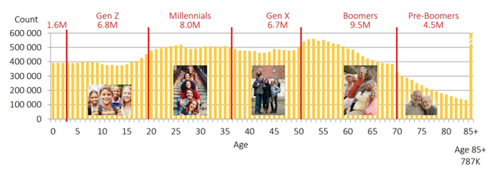
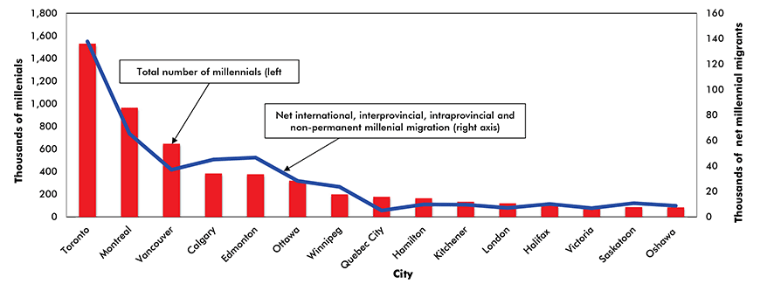
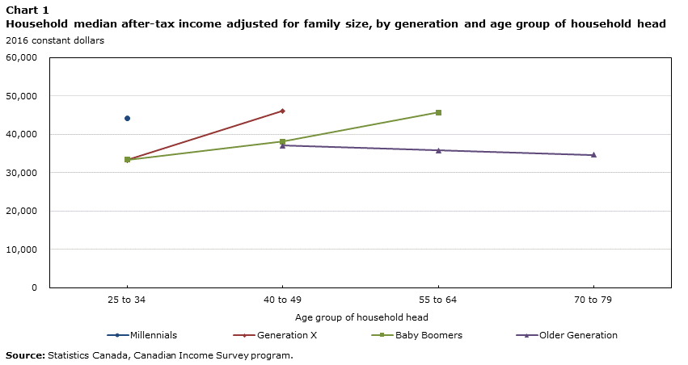
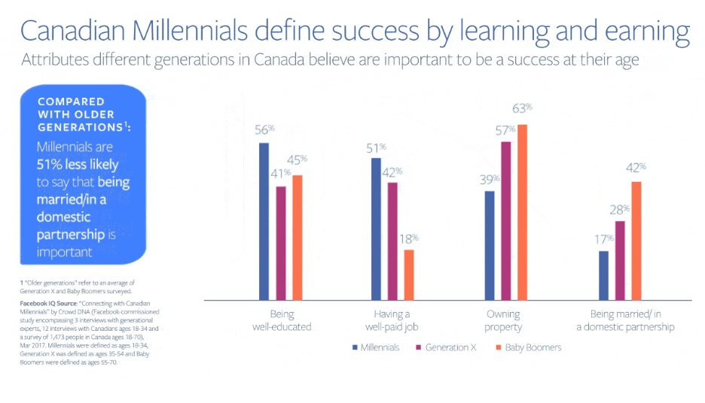
Segmentation
Size of Segment
Where is the Segment
Market Segmentation
Demographics
Age
Gender
Psychographics
Culture
Lifestyles
The Financial Muscle
The Difference
Notes:
Stats Canada
Over the last decade, millennials began to enter the labour market or pursue post-secondary studies. Though early in their life cycle and their prime working years, millennials had higher real median after-tax household incomes than baby boomers or Gen-Xers at the same age. For example, adjusted household income for millennials between 25 and 34 years old reached $44,100 in 2016, compared to $33,300 for Gen-Xers at the same age in 1999 (Chart 1).^{Note}

Slide 23
Knowing the Segment
The millennial shopper
What influences millennial shoppers?
Highly Educated (50% have a Bachelors or master’s degree)
They live with an average of 03 people
64% live with at least one other person that shops online
They surf the web via mobile (51%), desktop (38%), tablet (11%)
20% compare all-in costs
31% trust customer ratings and reviews
19% check a company’s policy before purchase
22% made a purchase after viewing social media
Notes:
Canada Post
This is a social media friendly segment which loves to follow what is going on social media. Ratings and references are the most important factors especially when it comes to purchasing a big-ticket item. They have the tendency to believe the unbiased reviewers rather than company’s ads. Youtube channels like Carwow (UK), James May (UK), Top Gear (UK), Redline reviews (USA), Doug DeMuro (USA), AutoExpert (Australia) and the StarighPipes (Canada) can play an important role in sales.
yconic. (September 19, 2016). Car purchase considerations rated the highest by Gen Y and Z respondents in Canada as of 2016 [Graph]. In Statista. Retrieved August 29, 2019, from https://www.statista.com/statistics/610881/canada-main-car-purchase-considerations-by-gen-y-and-z/

Slide 24
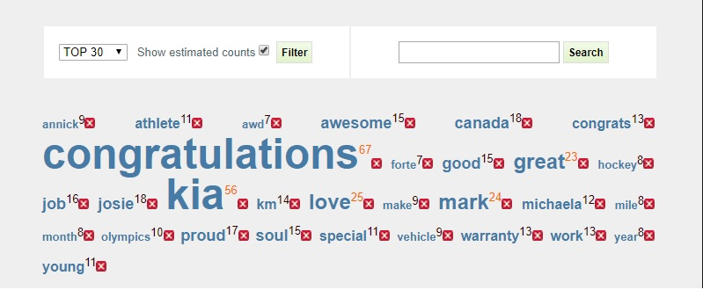
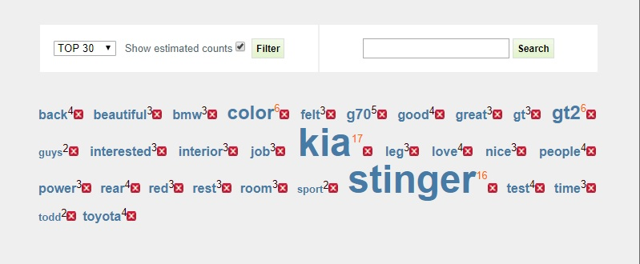
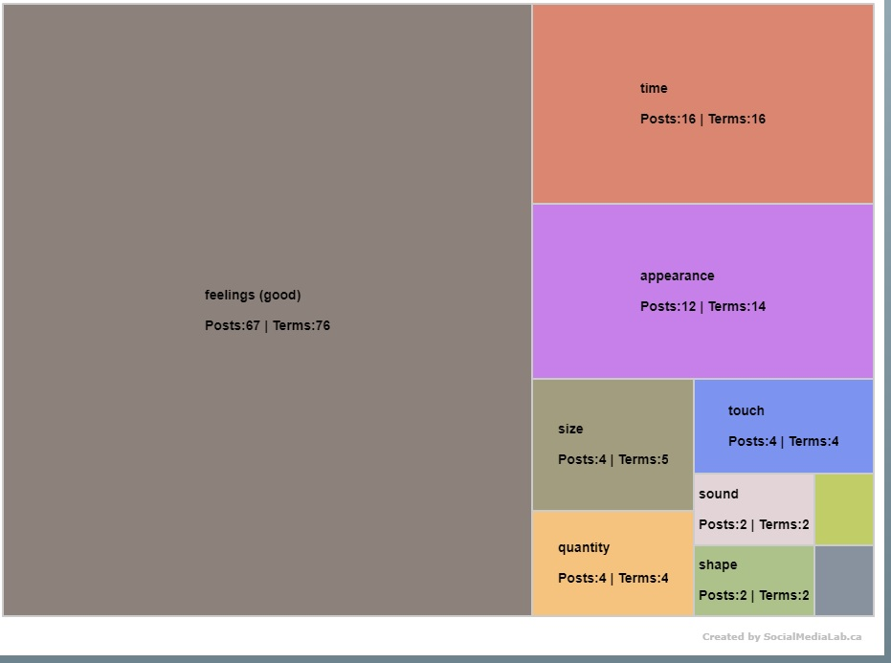
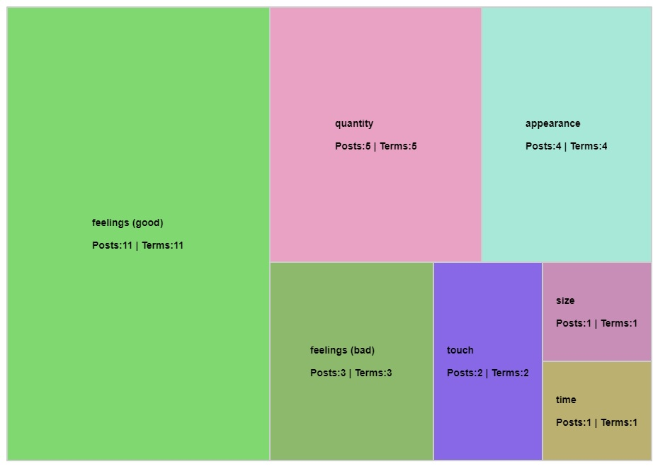
Kia Canada – Facebook
Kia Stinger – Forum - Facebook
Words cloud
Words cloud
Treemap
Treemap
Social Media Analysis
Notes:
In order to have a quick check of brand value, I carried out the social media analysis of Kia Canada and Kia Stinger Forum by using the Facebook pages. The two visualizations – Words Cloud and Treemap – provide a snapshot of the comments by the users. It can be observed that people are generally happy with Kia as a brand and Stinger as a product.

Slide 25
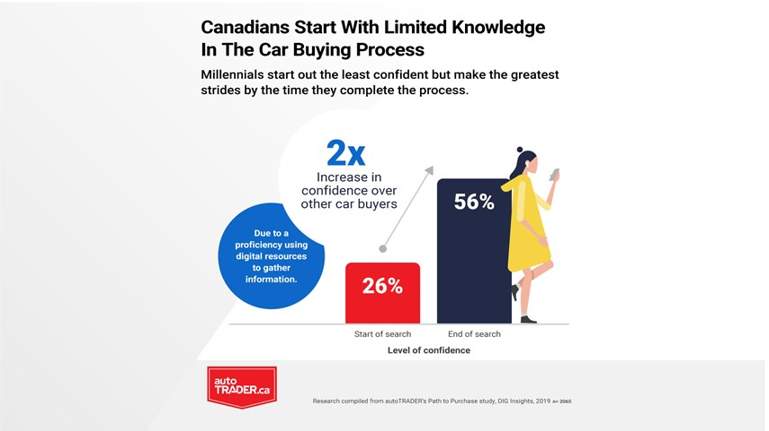
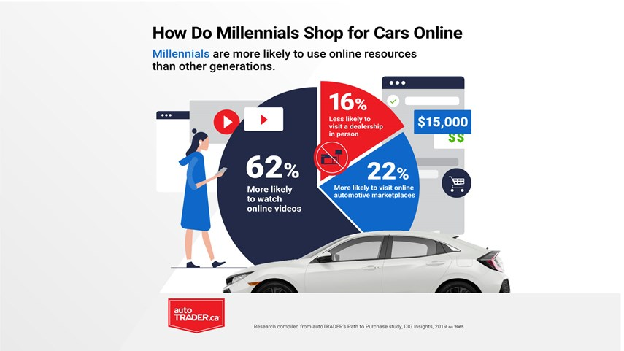
Factors important while purchasing a luxury vehicle
06 months
05 years
Use existing customer data to increase reach regarding promotions
Increase incentives for referring customers
Increase participation in events to improve brand activation
Increase test and trial by offering promotions
Highlight two factors – value for money and reliability in all ads
Improve brand position in blogs & other online touchpoints
Develop Kia Stinger Owners’ Club and Kia Stinger App
Use social media campaigns and connect with online influencers
Support a worthy cause with your message
Create an experience to improve participation for sharing online
Self Esteem
Passion
Consumer Experience
Build Quality
Exclusivity
Improving Stinger Sales

Slide 26

Q&A?

